Slide 1
kNN

Slide 2
Instance based learning
Approximating real valued or discrete-valued target functions
Learning in this algorithm consists of storing the presented training data
When a new query instance is encountered, a set of similar related instances is retrieved from memory and used to classify the new query instance

Slide 3
Construct only local approximation to the target function that applies in the neighborhood of the new query instance
Never construct an approximation designed to perform well over the entire instance space
Instance-based methods can use vector or symbolic representation
Appropriate definition of „neighboring“ instances

Slide 4
Disadvantage of instance-based methods is that the costs of classifying new instances can be high
Nearly all computation takes place at classification time rather than learning time

Slide 5
K-Nearest Neighbor algorithm
Most basic instance-based method
Data are represented in a vector space
Supervised learning

Slide 6
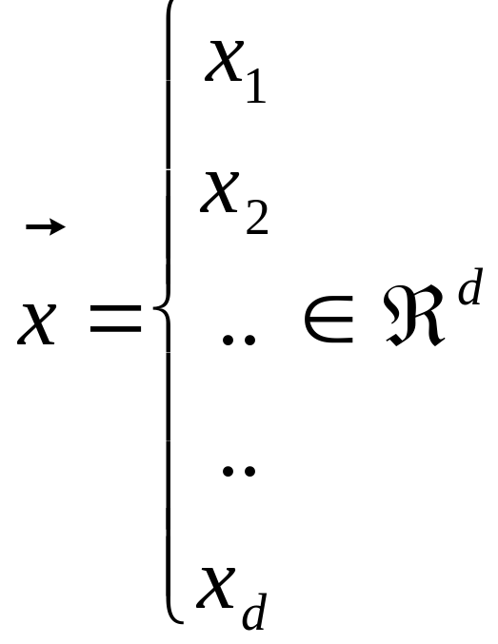
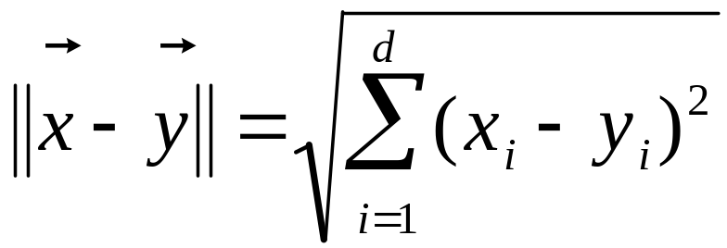
Feature space

Slide 7
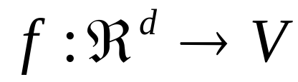
In nearest-neighbor learning the target function may be either discrete-valued or real valued
Learning a discrete valued function
, V is the finite set {v₁,......,v_{n}}
For discrete-valued, the k-NN returns the most common value among the k training examples nearest to xq.

Slide 8
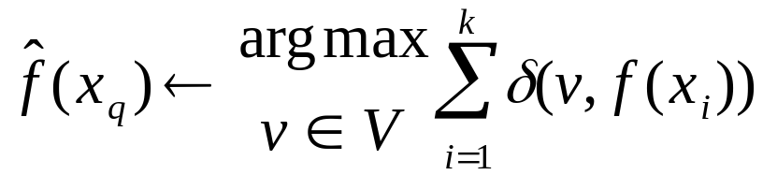
Training algorithm
  For each training example <x,f(x)> add the example to the list
Classification algorithm
  Given a query instance x_{q} to be classified
    Let x₁,..,x_{k} k instances which are nearest to x_{q}
    Where δ(a,b)=1 if a=b, else δ(a,b)= 0 (Kronecker function)

Slide 9
Definition of Voronoi diagram
the decision surface induced by 1-NN for a typical set of training examples.
_
.
_
_
.
+
_
.
+
.
.
_
xq
+
_
.
+

Slide 10
kNN rule leeds to partition of the space into cells (Vornoi cells) enclosing the training points labelled as belonging to the same class
The decision boundary in a Vornoi tessellation of the feature space resembles the surface of a crystall

Slide 11
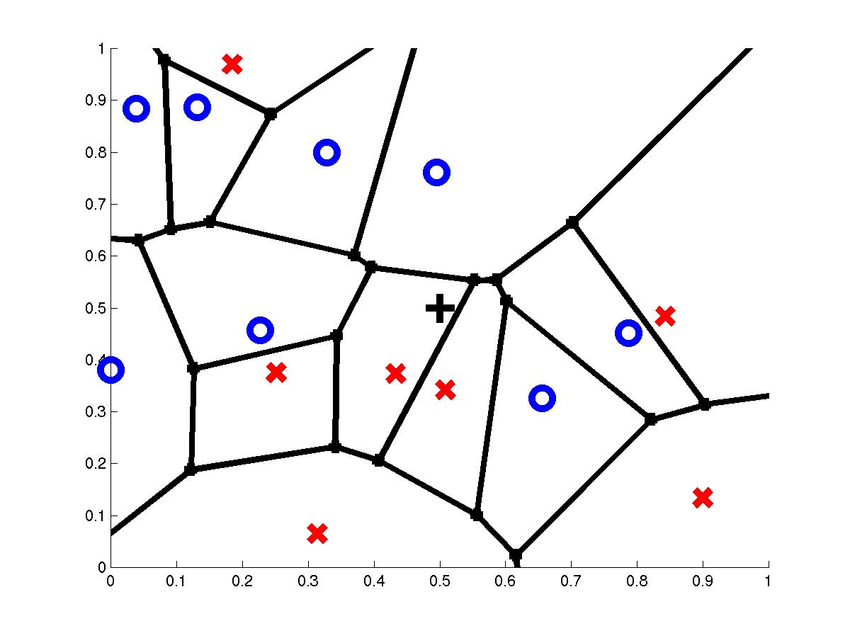
1-Nearest Neighbor
query point q_{f}
nearest neighbor q_{i}

Slide 12
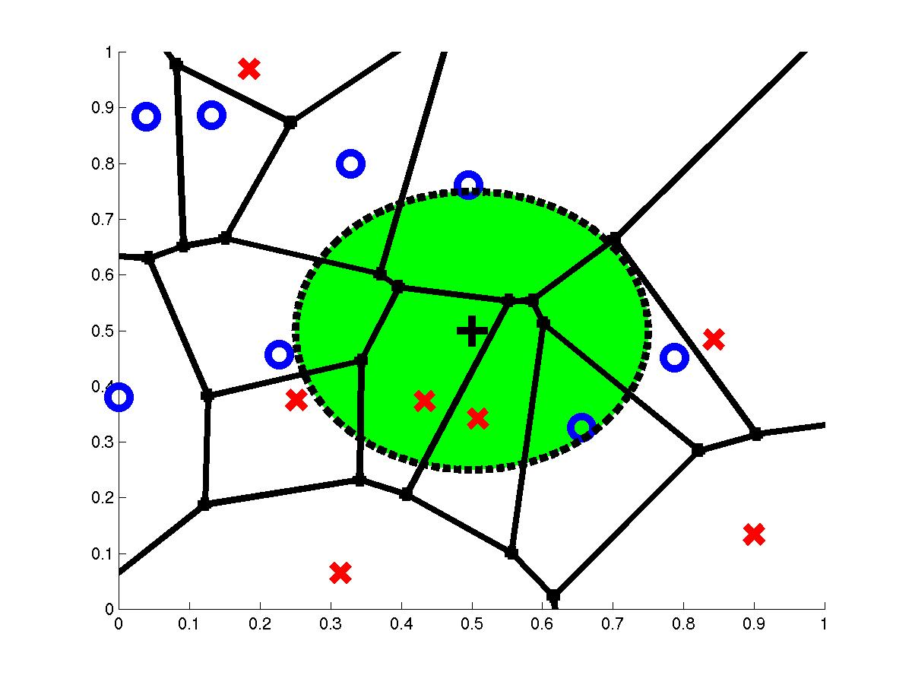
3-Nearest Neighbors
query point q_{f}
3 nearest neighbors
2x,1o

Slide 13
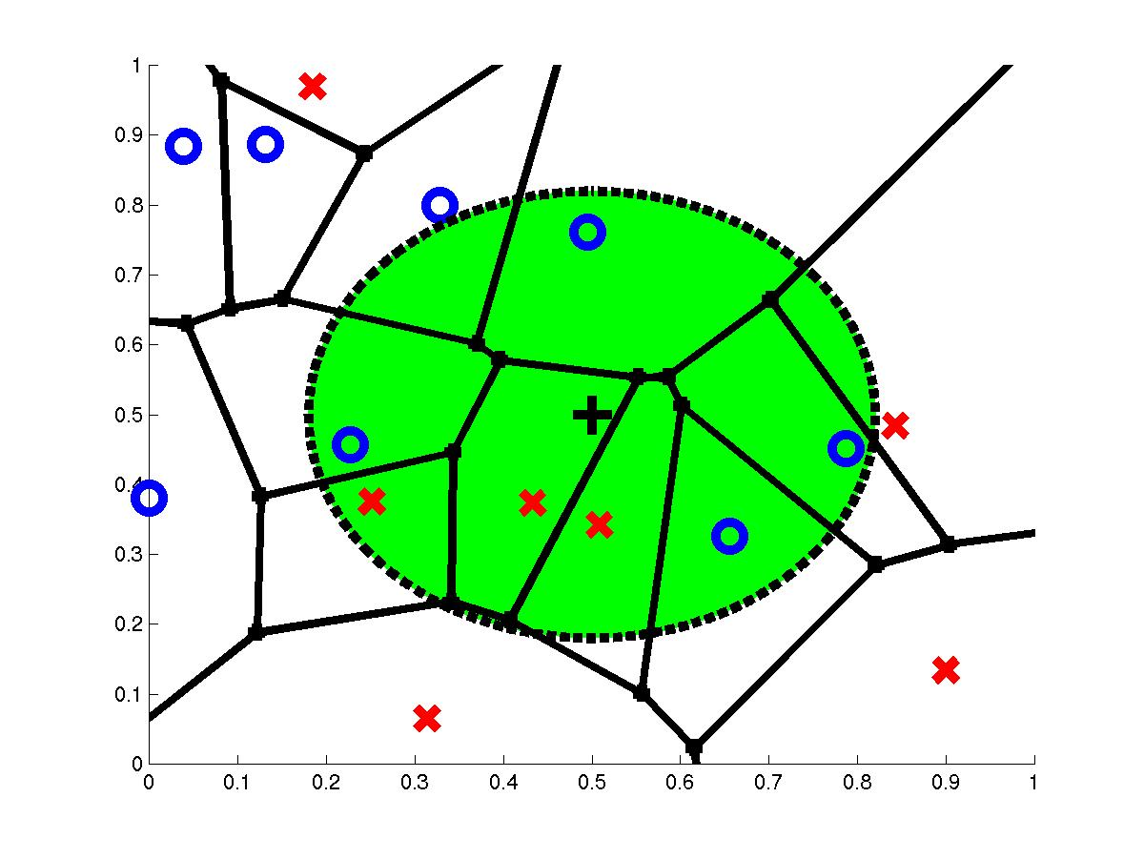
7-Nearest Neighbors
query point q_{f}
7 nearest neighbors
3x,4o

Slide 14
How to determine the good value for k?
Determined experimentally
Start with k=1 and use a test set to validate the error rate of the classifier
Repeat with k=k+2
Choose the value of k for which the error rate is minimum
Note: k should be odd number to avoid ties

Slide 15
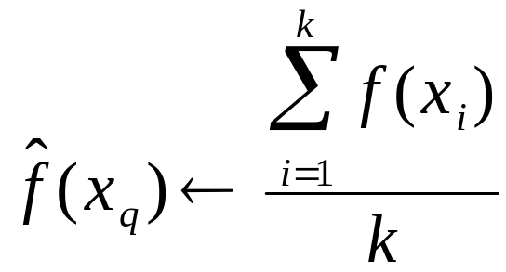
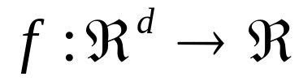
Continous-valued target functions
kNN approximating continous-valued target functions
Calculate the mean value of the k nearest training examples rather than calculate their most common value

Slide 16
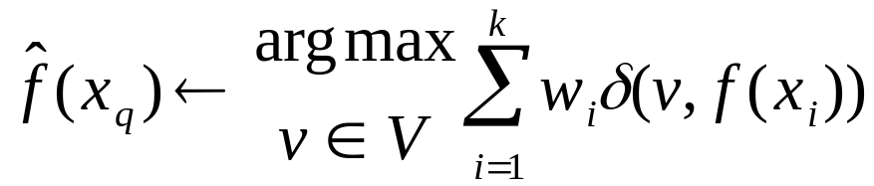
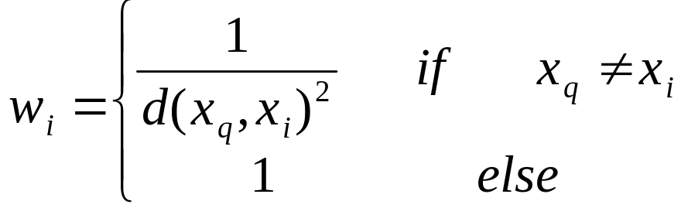
Distance Weighted
Refinement to kNN is to weight the contribution of each k neighbor according to the distance to the query point x_{q}
  Greater weight to closer neighbors
  For discrete target functions

Slide 17
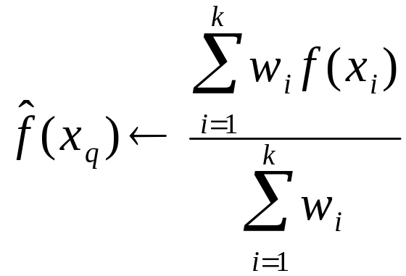
Distance Weighted
  For real valued functions

Slide 18
Curse of Dimensionality
Imagine instances described by 20 features (attributes) but only 3 are relevant to target function
Curse of dimensionality: nearest neighbor is easily misled when instance space is high-dimensional
Dominated by large number of irrelevant features
Possible solutions
Stretch j-th axis by weight z_{j}, where z₁,…,z_{n} chosen to minimize prediction error (weight different features differently)
Use cross-validation to automatically choose weights z₁,…,z_{n}
Note setting z_{j} to zero eliminates this dimension alltogether (feature subset selection)
PCA

Slide 19
When to Consider Nearest Neighbors
Instances map to points in R^{d}
Less than 20 features (attributes) per instance, typically normalized
Lots of training data
Advantages:
Training is very fast
Learn complex target functions
Do not loose information
Disadvantages:
Slow at query time
  Presorting and indexing training samples into search trees reduces time
Easily fooled by irrelevant features (attributes)

Slide 20
Practical
https://github.com/Nazanin1369/DataMining-KNN/blob/master/main.py
https://github.com/Nazanin1369/DataMining-KNN/blob/master/README.md
https://github.com/Nazanin1369/DataMining-KNN/tree/master/data

